Slide 1
Theory of Automata
Lecture # 16
Dr. Muhammad Fayaz

Slide 2
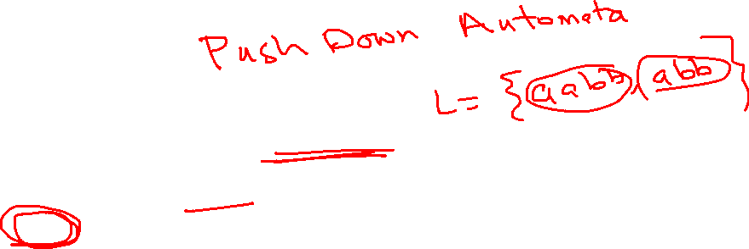
PDA
PDAs are like NFAs but have an extra component called a stack
The stack provides additional memory beyond the finite amount available in the control
The stack allows PDA to recognize some non-regular languages

Slide 3
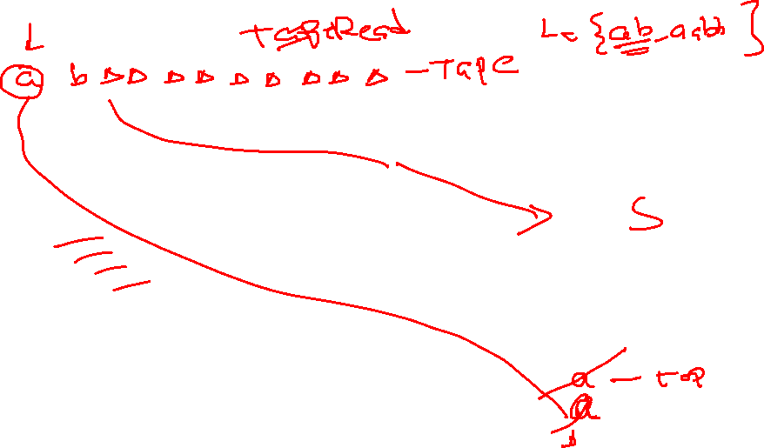
Pushdown Automaton - PDA
Input String
Stack
States

Slide 4
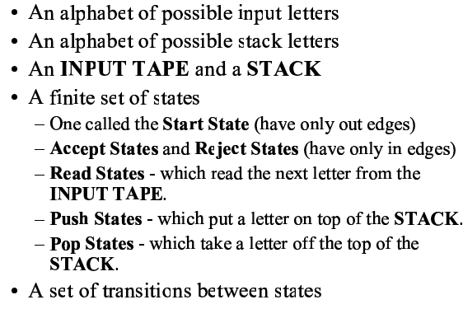
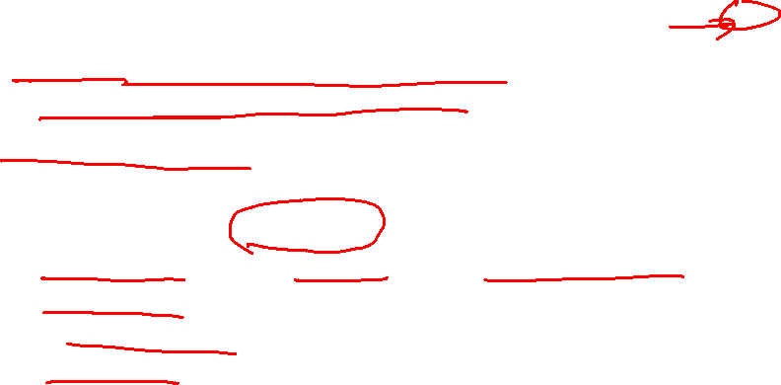
Push Down Automata
A PDA is a collection of

Slide 5
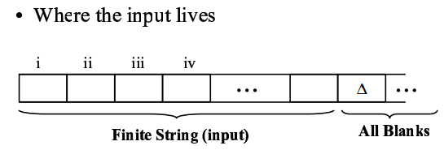
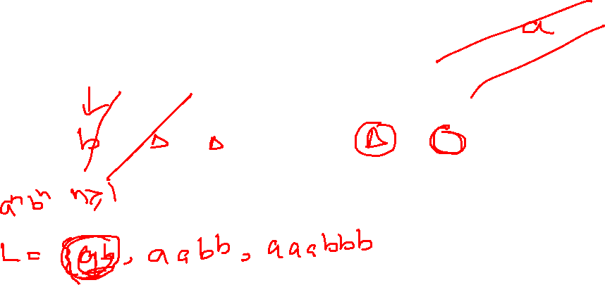
Input Tape & Stack
∆
Stack

Slide 6
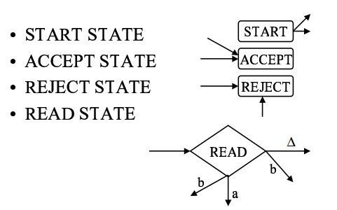
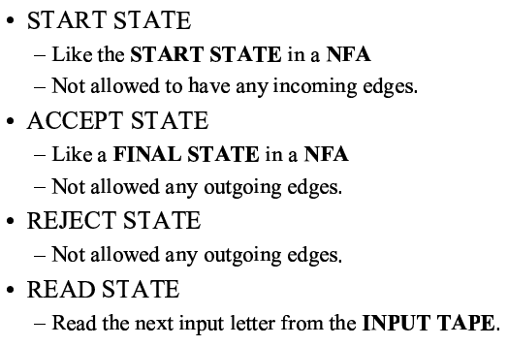
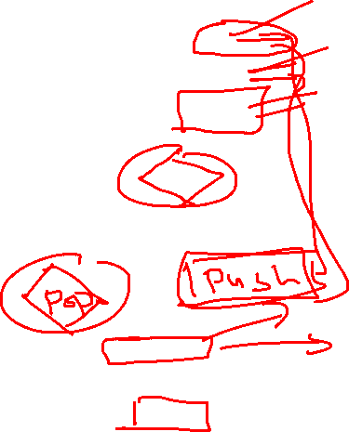
States

Slide 7
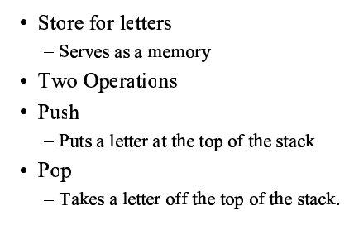
Stack

Slide 8
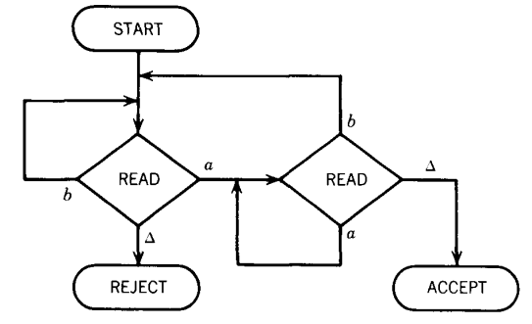
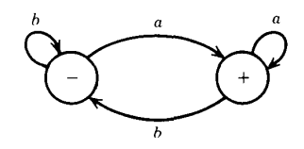
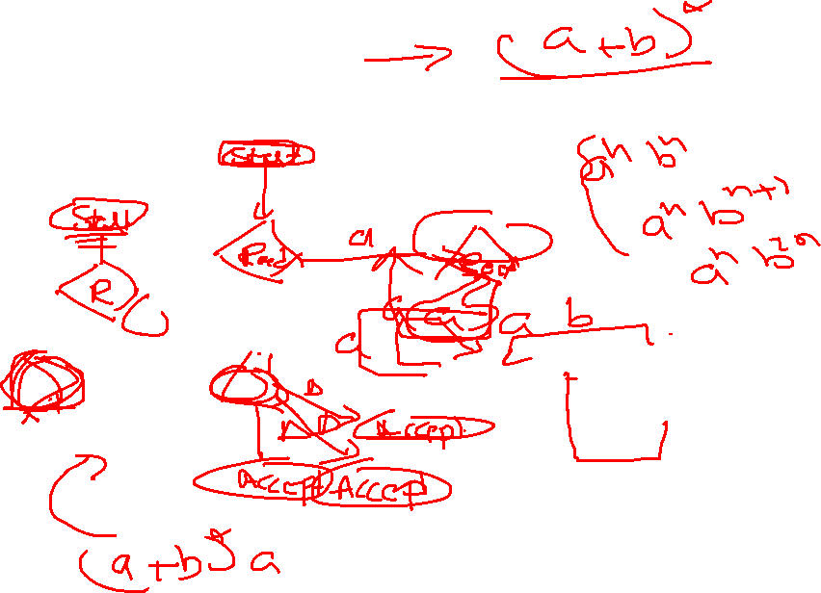
Example
DFA and Equitant PDA that accepts all words ending with letter a

Slide 9
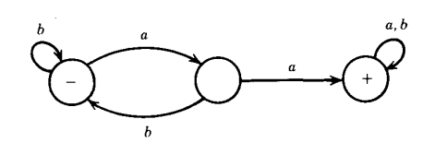
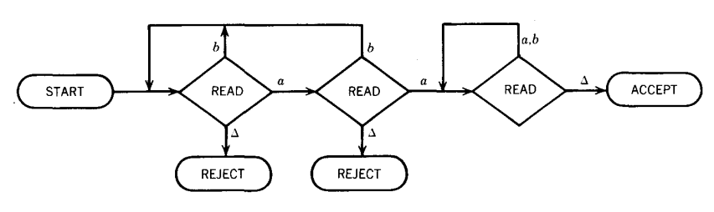
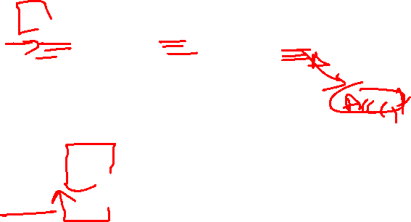
Example
DFA and Equitant DFA for a Language that accept all words contains at least a double aa

Slide 10
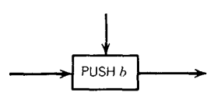
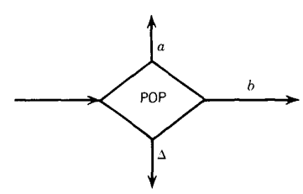
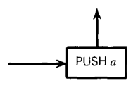
Stack Operations

Slide 11


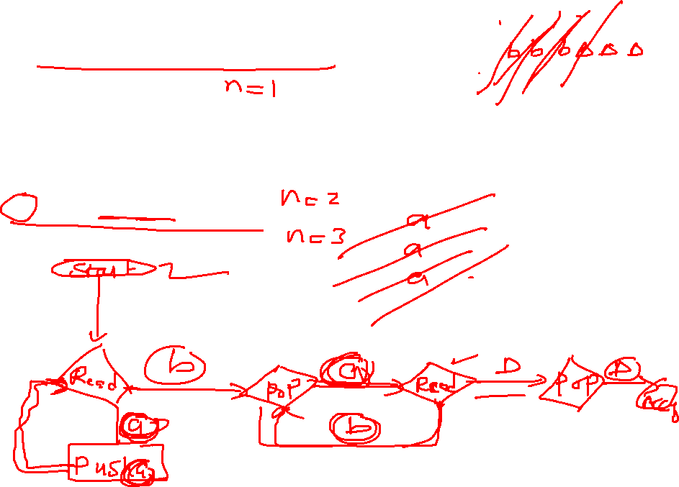
PDA for a^{n}b^{n}
Input Tape
$$\{n≥1 \}$$
 |  |  |  |  |  |  |  |  | ∆
1. Push all a’s in stack
∆
2. Compare a’s one by one in stack with b’s in the tape and delete a’s as well as b’s
$$\{ab, aabb, aaabbb, ………\}$$
Stack

Slide 12
PDA for a^{n}b^{n}
Input Tape
$$\{n≥1 \}$$
 |  |  |  |  |  |  |  |  | ∆
1. Push all a’s in stack
∆
2. Compare a’s one by one in stack with b’s in the tape and delete a’s as well as b’s
$$\{ab, aabb, aaabbb, ………\}$$
Stack

Slide 13

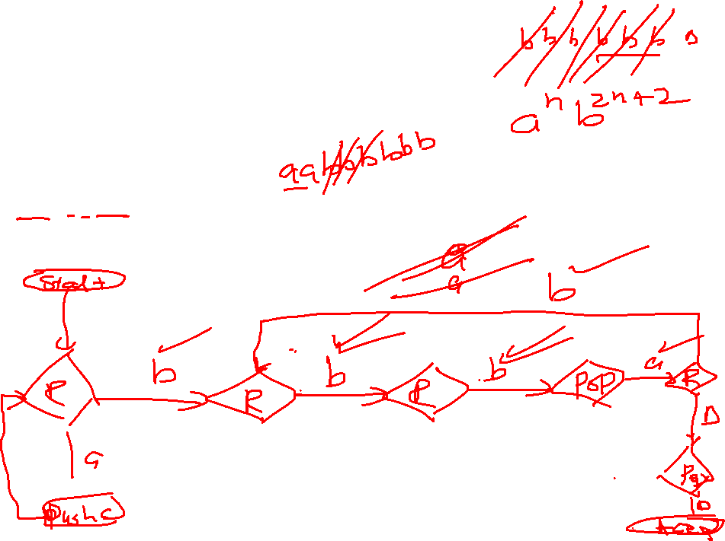
PDA for a^{n}b^{2n}
Input Tape
$$\{n≥1 \}$$
 |  |  |  |  |  |  |  |  | ∆
1. Push all a’s in stack
∆
2. Compare a’s one by one in stack with b’s in the tape and delete a’s as well as b’s
$$\{abb, aabbbb, aaabbbbbb, ………\}$$
Stack

Slide 14

PDA for a^{n}b^{2n}
Input Tape
$$\{n≥1 \}$$
 |  |  |  |  |  |  |  |  | ∆
1. Push all a’s in stack
∆
2. Compare a’s one by one in stack with b’s in the tape and delete a’s as well as b’s
$$\{abb, aabbbb, aaabbbbbb, ………\}$$
Stack

Slide 15

PDA for a^{2n}b^{2n}
Input Tape
$$\{n≥1 \}$$
 |  |  |  |  |  |  |  |  | ∆
1. Push all a’s in stack
∆
2. Compare a’s one by one in stack with b’s in the tape and delete a’s as well as b’s
$$\{aabb, aaaabbbb, aaaaaabbbbbb,……\}$$
Stack

Slide 16
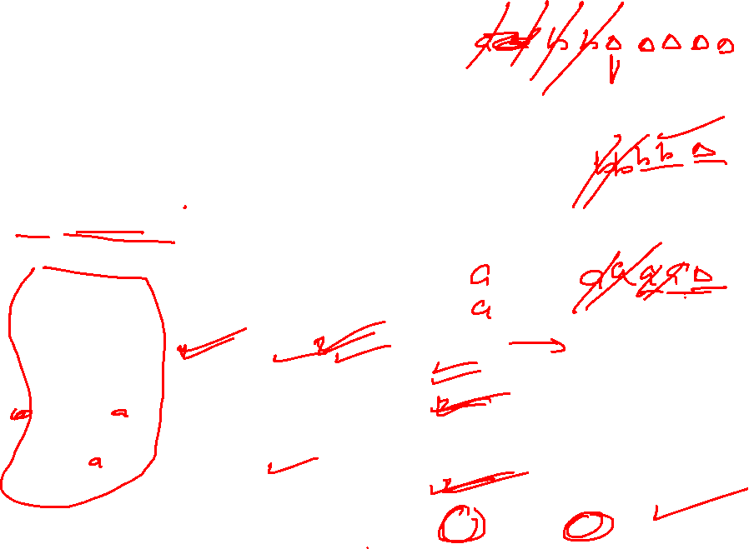
PDA for a^{2n}b^{2n}
Input Tape
$$\{n≥1 \}$$
 |  |  |  |  |  |  |  |  | ∆
1. Push all a’s in stack
∆
2. Compare a’s one by one in stack with b’s in the tape and delete a’s as well as b’s
$$\{aabb, aaaabbbb, aaaaaabbbbbb,……\}$$
Stack

Slide 17

PDA for a^{n}b^{n+1}
Input Tape
$$\{n≥1 \}$$
 |  |  |  |  |  |  |  |  | ∆
1. Push all a’s in stack
∆
2. Compare a’s one by one in stack with b’s in the tape and delete a’s as well as b’s
$$\{abb, aabbb, aaabbbb, ………\}$$
Stack

Slide 18

PDA for a^{n}b^{n+1}
Input Tape
$$\{n≥1 \}$$
 |  |  |  |  |  |  |  |  | ∆
1. Push all a’s in stack
∆
2. Compare a’s one by one in stack with b’s in the tape and delete a’s as well as b’s
$$\{abb, aabbb, aaabbbb, ………\}$$
Stack

Slide 19

PDA for a^{n}b^{2n+1}
$$\{n≥1 \}$$
 |  |  |  |  |  |  |  |  | ∆
1. Push all a’s in stack
∆
2. Compare a’s one by one in stack with b’s in the tape and delete a’s as well as b’s
$$\{abbb, aabbbbb, aaabbbbbbb,……\}$$

Slide 20
PDA for a^{n}b^{2n+1}
$$\{n≥1 \}$$
 |  |  |  |  |  |  |  |  | ∆
1. Push all a’s in stack
∆
2. Compare a’s one by one in stack with b’s in the tape and delete a’s as well as b’s
$$\{abbb, aabbbbb, aaabbbbbbb,……\}$$

Slide 21


PDA for a^{n}b^{n}
Input Tape
∆
 |  |  |  |  |  |  |  |  | ∆
$$\{n≥0 \}$$
1. Push all a’s in stack
2. Compare a’s one by one in stack with b’s in the tape and delete a’s as well as b’s
$$\{∆,ab, aabb, aaabbb, ………\}$$
Stack

Slide 22
PDA for a^{n}b^{n}
Input Tape
∆
 |  |  |  |  |  |  |  |  | ∆
$$\{n≥0 \}$$
1. Push all a’s in stack
2. Compare a’s one by one in stack with b’s in the tape and delete a’s as well as b’s
$$\{∆,ab, aabb, aaabbb, ………\}$$
Stack

Slide 23
PDA for a^{n}b^{n}
Input Tape
∆
 |  |  |  |  |  |  |  |  | ∆
$$\{n≥0 \}$$
1. Push all a’s in stack
2. Compare a’s one by one in stack with b’s in the tape and delete a’s as well as b’s
$$\{∆,ab, aabb, aaabbb, ………\}$$
Stack

Slide 24


PDA for a^{n}b^{n-1}
Input Tape
∆
 |  |  |  |  |  |  |  |  | ∆
$$\{n≥1 \}$$
1. Push all a’s in stack
2. Compare a’s one by one in stack with b’s in the tape and delete a’s as well as b’s
$$\{a,aab, aaabb, aaaabbb, ………\}$$
Stack

